Slide 1
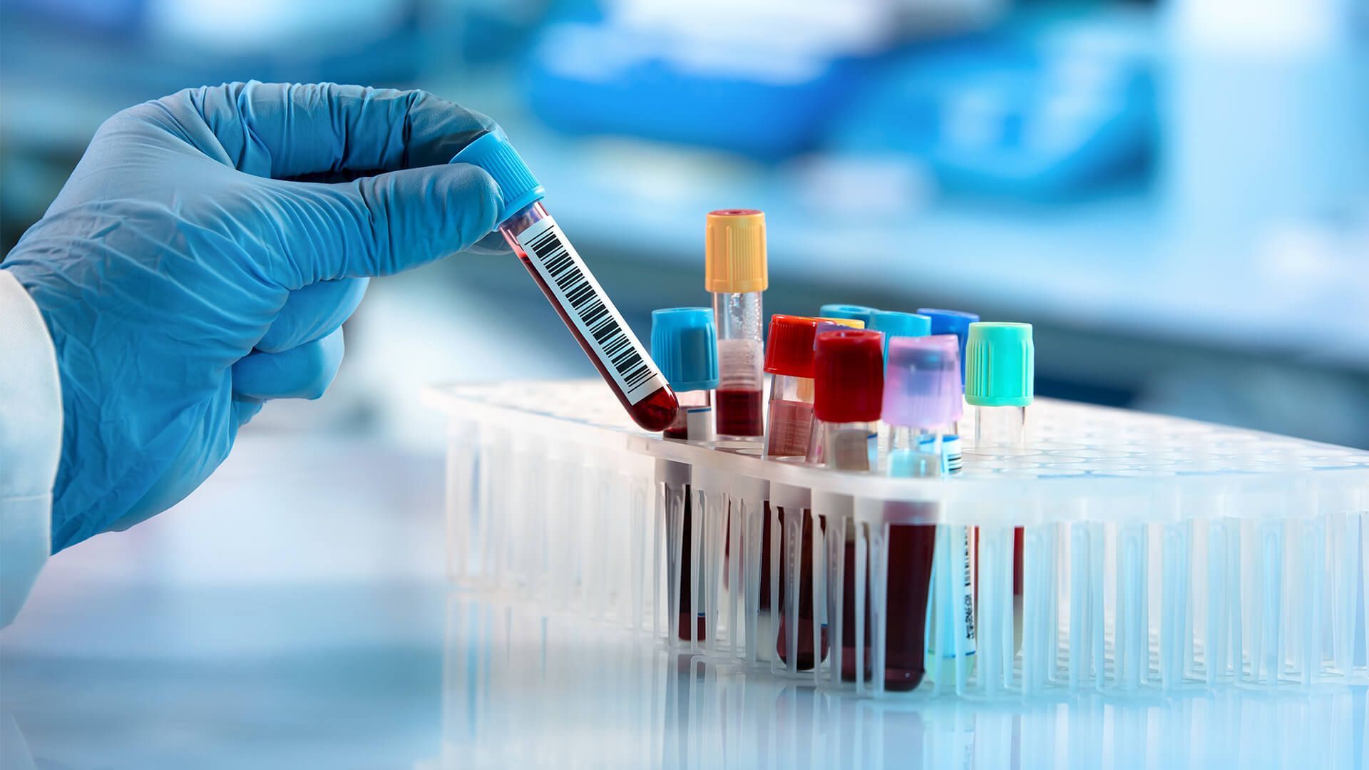
Blood Cancer Detection Using Microscopic Images
Team:
B.Harish(17VV1A0507)
M.Hemalata(17VV1A0526)
P.Pranaya Durga(17VV1A0534)
B.Rhema Sravya(17VV1A0508)
GUIDE : Dr. P. Aruna Kumari

Slide 2
CONTENTS
Problem Statement
System Architecture
Working of CNN
Layers in CNN
Image Pre-processing
Conclusion

Slide 3
Problem Statement
Blood cell segmentation and identification is a vital in the study of blood as a health indicator. A complete blood count is used to determine the state of a person’s health based on the contents of the blood in particular the white blood cells and the red blood cells. The main problem arises when massive amounts of blood samples are required to be processed by the hematologist or Medical Laboratory Technicians.
Leukemia is a term used for diseases in which abnormal cells divide without control and are able to invade other tissues. Leukemic cells can spread to other parts of the body through the blood and lymph systems.

Slide 4
System Flow
Classification using CNN
Image Dataset
Image Pre-processing
Features Extraction
Cancer
Normal
Image
Pre-Processing
Test Image
Feature Extractions using CNN

Slide 5
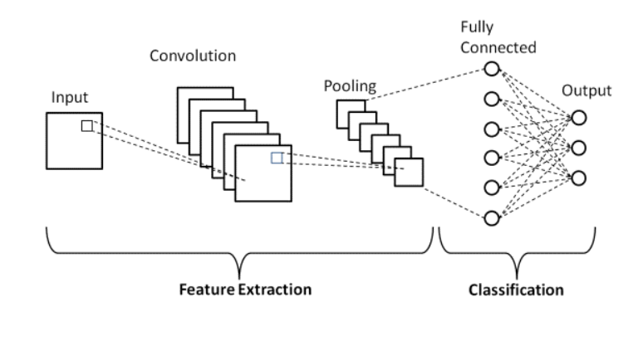
Basic Architecture of CNN

Slide 6
Working of CNN
We have implemented CNN for the feature extraction and classification of the blood samples.
A CNN is a multilayered neural network with a special architecture to detect complex features in data. CNNs have been used in image recognition, powering vision in robots, text in images and for self-driving vehicles.
The CNN consist layer of neurons and it is optimized for two-dimensional pattern recognition.
CNN has three types of layer namely convolutional layer, pooling layer and fully connected layer.

Slide 7
Layers in CNN
Convolutional Layer :
This layer is the first layer that is used to extract the various features from the input images.
In this layer, the mathematical operation of convolution is performed between the input image and a filter of a particular size M x M.
By sliding the filter over the input image, the dot product is taken between the filter and the parts of the input image with respect to the size of the filter (M x M).
The output is termed as the Feature map which gives us information about the image such as the corners and edges. Later, this feature map is fed to other layers to learn several other features of the input image.

Slide 8
Pooling Layer :
The primary aim of this layer is to decrease the size of the convolved feature map to reduce the computational costs.
This is performed by decreasing the connections between layers and independently operates on each feature map.
Depending upon method used, there are several types of Pooling operations.
In Max Pooling, the largest element is taken from feature map.
Average Pooling calculates the average of the elements in a predefined sized Image section.
The total sum of the elements in the predefined section is computed in Sum Pooling.
The Pooling Layer usually serves as a bridge between the Convolutional Layer and the FC Layer

Slide 9
Fully Connected Layer
The Fully Connected (FC) layer consists of the weights and biases along with the neurons and is used to connect the neurons between two different layers.
These layers are usually placed before the output layer and form the last few layers of a CNN Architecture.
In this, the input image from the previous layers are flattened and fed to the FC layer.
The flattened vector then undergoes few more FC layers where the mathematical functions operations usually take place. In this stage, the classification process begins to take place.

Slide 10
Dropout :
Usually, when all the features are connected to the FC layer, it can cause overfitting in the training dataset.
Overfitting occurs when a particular model works so well on the training data causing a negative impact in the model’s performance when used on a new data.
To overcome this problem, a dropout layer is utilized wherein a few neurons are dropped from the neural network during training process resulting in reduced size of the model.
On passing a dropout of 0.3, 30% of the nodes are dropped out randomly from the neural network.

Slide 11
Activation Functions :
Finally, one of the most important parameters of the CNN model is the activation function. They are used to learn and approximate any kind of continuous and complex relationship between variables of the network.
In simple words, it decides which information of the model should fire in the forward direction and which ones should not at the end of the network.
It adds non-linearity to the network. There are several commonly used activation functions such as the ReLU, SoftMax, tanH and the Sigmoid functions. Each of these functions have a specific usage. For a binary classification CNN model, sigmoid and ReLU functions are preferred an for a multi-class classification, generally SoftMax is used.

Slide 12
Pre-processing Methods :
Image pre-processing has to apply some operations to images, like enhance an image, extract useful information and analyze it and make decisions.
It is the important method that influences automated detection of defects. The following are some preprocessing methods :
Noise e denoising
Contrast Enhancement (Histogram equalization, Adaptive Histogram equalization)
Segmentation
Morphological Operations, etc…

Slide 13
Noise e denoising
Image Noise : It is a random variation of brightness or color information in images and an undesirable by-product of image that obscures the desired information. Generally, noise is introduced into the image during image transmission, acquisition, coding or processing steps.
Various types of Image Noise :-
Gaussian Noise
Salt and Pepper Noise(Data Dropout)
Speckle Noise
Poisson Noise
Image Denoising: It is a process to reserve the details of an image while removing the random noise from the image as far as possible.
We classify the image denoising filters into 2 broad categories : -
1) Traditional Filters(Filters which are traditionally used to remove noise from images.)
2) Fuzzy Based Filters(Filters which include the concept of fuzzy logic in their filtering procedure.)

Slide 14
Contrast Enhancement Adaptive Histogram Equalization:
Adaptive histogram equalization (AHE) is a computer image processing technique used to improve contrast in images.
It differs from ordinary histogram equalization in the respect that the adaptive method computes several histograms, each corresponding to a distinct section of the image, and uses them to redistribute the lightness values of the image.
It is therefore suitable for improving the local contrast and enhancing the definitions of edges in each region of an image. However, AHE has a tendency to overamplify noise in relatively homogeneous regions of an image

Slide 15
Adaptive Histogram Steps :
In the adaptive algorithms each pixel is modified based on the pixels that is in a region surrounding that pixel. This region is called contextual region.
The adaptive histogram equalizations is computationally intense and for this reason was developed some methods to increase the speed of the original method.
If we have an image of n x n pixels, with k intensity levels and the size of contextual region is m x m, then the time required for calculations is O(n^2 (m + k)).
Better results are obtained if we use instead of the histogram of neighborhood pixels from a moving window only four nearest grid points. The transformation of each pixel is made by interpolating mappings of the four nearest points .

Slide 16
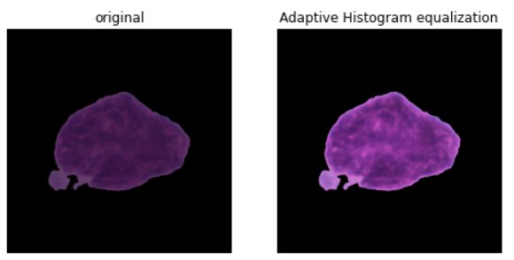
If (x , y) is a pixel of intensity i from the image, then we note with m_{+,−} the mapping of right upper x_{+,−}, m_{+,+} the mapping of right lower x_{+,+} , m_{−,+} the mapping of left lower x_{−,+} and m_{−,−} the mapping of left lower x_{−,−}, then the interpolated adaptive histogram equalization is compute with:
m(i) = a [bm_{−,−}(i) + (1 − b)m_{+,−}(i)] + [1 − a] [bm_{−,+}(i) + (1 − b)m_{+,+}(i)]
where a = (y − y₋ ) / (y₊ − y₋ ),
b = (x − x₋ ) / (x₊ − x₋ )

Slide 17
Example:
Let us Consider an image with Pixel values as described as below :
0 | 0 | 0 | 1 | 1 | 1
2 | 2 | 3 | 2 | 2 | 7
3 | 0 | 7 | 4 | 7 | 5
3 | 4 | 4 | 2 | 4 | 5
2 | 7 | 6 | 7 | 7 | 5
6 | 5 | 3 | 6 | 6 | 0
An Image with pixel values from 0-7

Slide 18
Pixel value | Frequency | Cumulative Frequency | Normalized Frequency(NF) | New pixel (NF * MP)
0 | 5 | 5 | 5/36 | 5/36 * 7 = 1 (approx.)
1 | 3 | 5+3 = 8 | 8/36 | 2
2 | 6 | 8+6 = 14 | 14/36 | 3
3 | 4 | 14+4 = 18 | 18/36 | 4
4 | 4 | 18+4 = 22 | 22/36 | 4
5 | 4 | 22+4 = 26 | 26/36 | 5
6 | 4 | 26+4 = 30 | 30/36 | 6
7 | 6 | 30+6 = 36 | 36/36 | 7
Maximum Pixel(MP)

Slide 19
Original Image
Original Pixel | New Pixel
0 | 1
1 | 2
2 | 3
3 | 4
4 | 4
5 | 5
6 | 6
7 | 7
0 | 0 | 0 | 1 | 1 | 1
2 | 2 | 3 | 2 | 2 | 7
3 | 0 | 7 | 4 | 7 | 5
3 | 4 | 4 | 2 | 4 | 5
2 | 7 | 6 | 7 | 7 | 5
6 | 5 | 3 | 6 | 6 | 0
New Image
1 | 1 | 1 | 2 | 2 | 2
3 | 3 | 4 | 3 | 3 | 7
4 | 1 | 7 | 4 | 7 | 5
4 | 4 | 4 | 3 | 4 | 5
3 | 7 | 6 | 7 | 7 | 5
6 | 5 | 4 | 6 | 6 | 1
Pixels values
are improved
0 1 2 3 4 5 6 7
Histogram

Slide 20
Conclusion :
Adaptive histogram equalization has the advantages of being automatic, reproducible, locally adaptive, and usually produces superior images when compared with interactive contrast enhancement.
It was proven that we can obtain better results if the original image has more dark regions.

Slide 21

THANK YOU

